Slide 1

GLOBAL SALES DIGITAL INSIGHTS LEARNINGS & JOURNEY THIS SUMMER
7 AUGUST 2017
Notes:
Hello everyone! Thanks for taking time out for this. I’d like to share my journey at Nike so far.

Slide 2
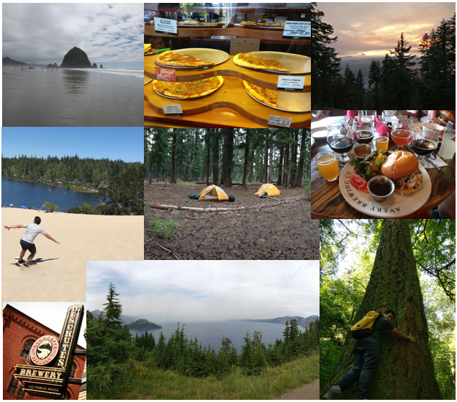
HELLO OREGON!
Rohan jha
Northwestern university (M.S. Analytics 2017)
Education
B.S. Electrical & Electronics Engineering (2006-2010)
Professional Experience
Software Engineer at Goldman Sachs (2010-2016)
Hobbies
Hiking / Camping / Food
… and Data Science

Slide 3

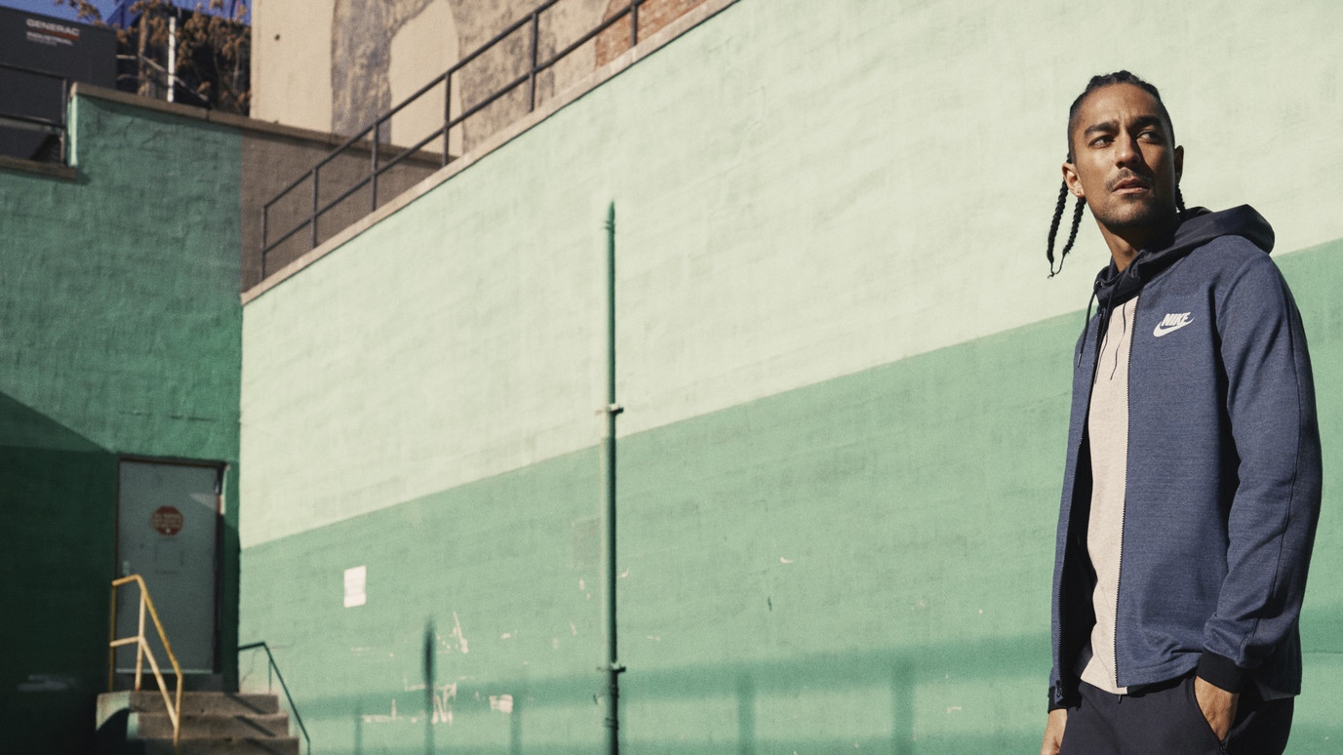
NIKE.NET HIGHLIGHTS
$12B
SALES IN 2016
THROUGH NIKE.NET
9TH
LARGEST E-COMMERCE PLATFORM
3RD
LARGEST WEBSITE
HOSTED ON AMAZON (AWS)
Notes:
Global Sales GTM – deal with B2B specifically digital experience on nike.net
$12B – 9th largest
Quoting Jim Scholefield

Slide 4
GAMEPLAN
CURRENT STATE
LONG-TERM VISION
Customers place their orders very close to season deadlines - Account Executives unable to react
Every customer gets the same user experience on nike.net
Proactive Engagement - Identify potential low-performing customers and take timely action to recoup revenue
Personalization – Customize nike.net for each customer to enhance digital shopping experience
Notes:
Nike.net is not perfect, yet! Two things that we wanted to focus for my project
The first one talks about the challenges that AE face every season. Futures activity (6-8 week). They tend to do this very close to the deadline - $100k example. Corresponding long-term vision is to empower AEs to proactively identify such customers and take appropriate actions to recover some of the revenue.
Second one - “One size does not fit all”
1st - 2x Speed
2nd – 2x Innovation

Slide 5

gameplan
PROACTIVE ENGAGEMENT REVENUE FORECASTING MODEL
PERSONALIZATION CUSTOMER PROFILING
Notes:
Started off with one project…

Slide 6
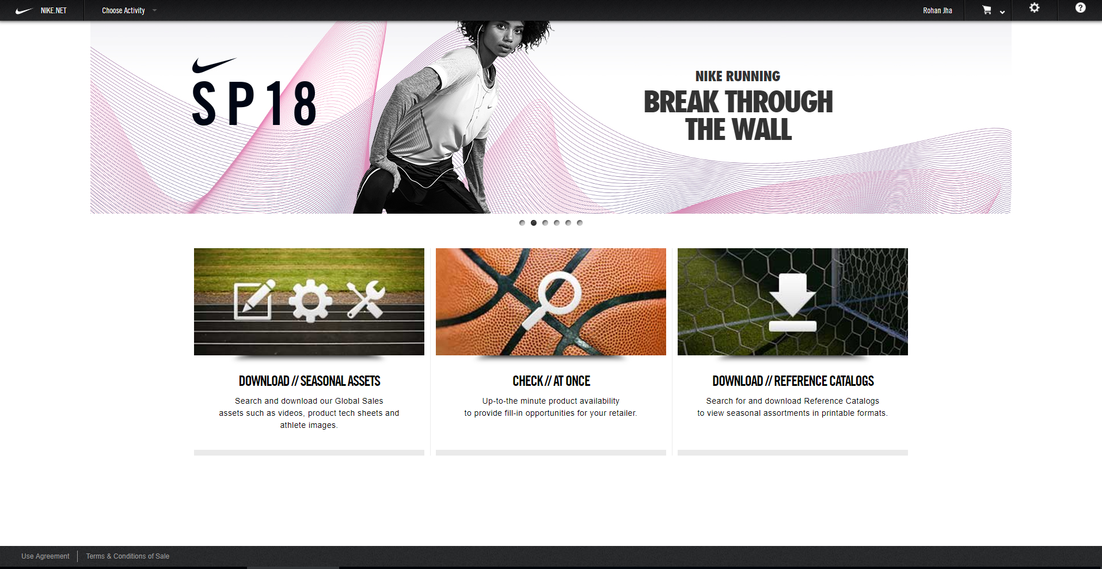
LEVERAGE DATA
NIKE.NET METRICS
Capture customer activity on the website.
Example metrics like Add/Remove products from cart, Campaign Views
NIKE.NET SALES
Orders and revenue from nike.net
Notes:
How do we plan to achieve this? Data Science.

Slide 7
REVENUE FORECASTING MODEL
METHODOLOGY
RESULTS
Aggregated data for each customer at a season level
Designed separate models for small and large customers due to high variance in revenue
Built forecasting models using different methods: Linear Regression, Random Forest, Gradient Boosted Machine. Random Forest performed slightly better than the rest
Fair model with not a very high accuracy
Main challenge – lack of data (only 3 seasons’ data)
The predictions will continue to improve as the model keeps learning new data
Non-trivial to predict human behaviour
Notes:
To tackle the first challenge of unpredictability of revenue -
Start messing around with data -> True to all DS projects, First half – Data cleaning and preparation
Feature engg. – Correlated variables, variable importance, At Once were removed
Variance – also small vs large behavior is different and captured better with separate models

Slide 8
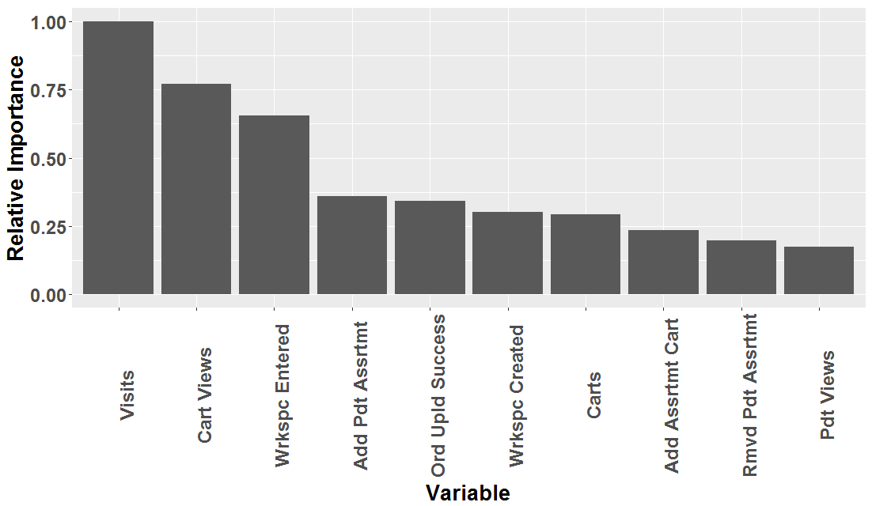
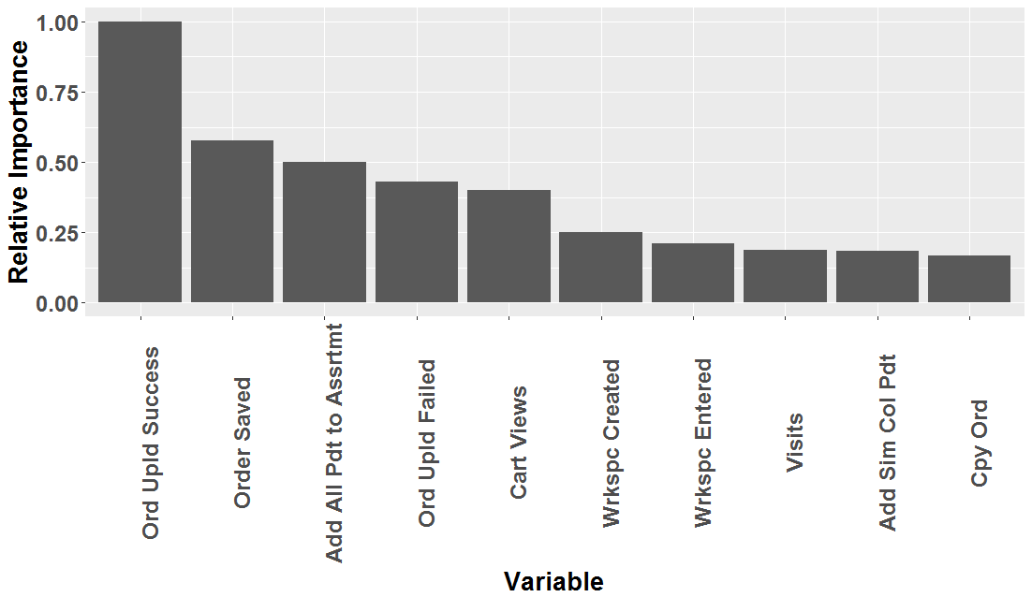
INSIGHTS FROM MODEL
SMALL CUSTOMERS
They are more engaged on the site and use it for product discovery and building shopping cart
Visits, Cart Views, Add/Remove Products are important variables
LARGE CUSTOMERS
They predominantly use the site to place orders and not so much for product discovery or to build assortments
Order Uploads, Save Orders, Add All Products are important variables
Notes:
Data Cleaning
Feature engg. – Correlated variables, variable importance
Variance – also small vs large behavior is different and captured better with separate models

Slide 9




CUSTOMER PROFILING
METHODOLOGY
Aggregated data for each customer at a season level
Created customer profiles using Archetype Analysis
RESULTS
AVERAGE USER
EXPLORER
MEDIA SAVVY
POWER USER
Does a little bit of everything - the average user.
The engaged user. Utilizes most nike.net features to discover new products, filter queries and eventually build assortments and carts.
Likes to dive deep into the content through media content like images, videos and ‘learn more’ sections.
The large accounts having dedicated merchandising teams. Uses nike.net mainly to place orders.
Notes:
2nd point of our vision – personalization for everyone
Segment or profile our customers based on how they interact with nike.net and these were the 4 profiles that we came up with

Slide 10
KEY TAKEAWAYS
REVENUE FORECASTING MODEL
CUSTOMER PROFILING
Observe fundamental differences in how small and large customers leverage nike.net
Explore potential for revenue growth from increasing nike.net engagement for large customers
Continue to learn from more data (incorporate seasonality) to deliver more accurate revenue forecasts
Understand our customers and their preferences better
Identify key customers for different features on the website to garner feedback
Perform more in-depth profiling as we gather more data

Slide 11
Sneak peek
IMPROVING USER EXPERIENCE FOR EMPLOYEES
Employee Engagement team conducted a survey evaluating productivity tools at Nike
Obtained 1300 different textual responses which cannot be summarized directly
Leverage natural language processing techniques to make sense of the survey
…STAY TUNED
Notes:
Would require manually going through each response (not scalable)

Slide 12


